Slide 1


Slide 3
Hi

Slide 4
I’m
MD. Rishad Saruar

Slide 5




Slide 6

Welcome to
My Presentation

Slide 7
It was a great experience for me to be able to get the opportunity to work and learn about new things in this institution.

Slide 8
Lets Go Then …

Slide 9


Somewhere in
Manikganj …

Slide 10
Somewhere in
Manikganj …

Slide 11
A building with structural beauty …
Probably known as তসলিম প্লাজা

Slide 12
This is the building where the institution is situated.

Slide 13
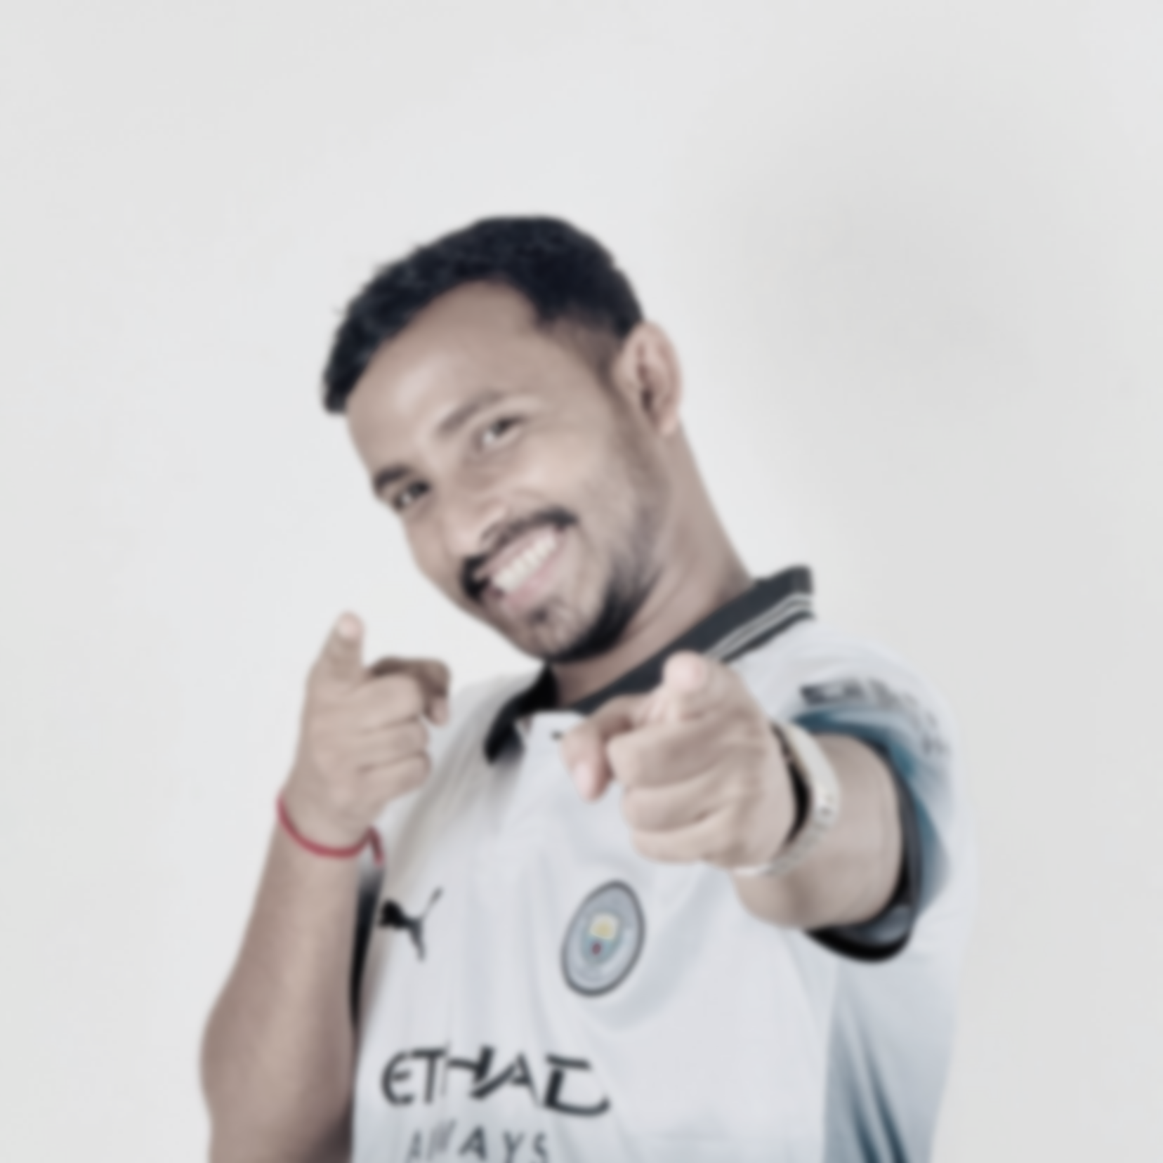
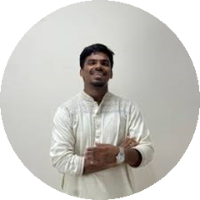
So, Let’s get to know are the people who helped me Learn and Achieve new skills.

Slide 14
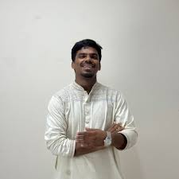
Scu. Shariful Islam
Founder & CEO of Shohoj IT Institute

Slide 15
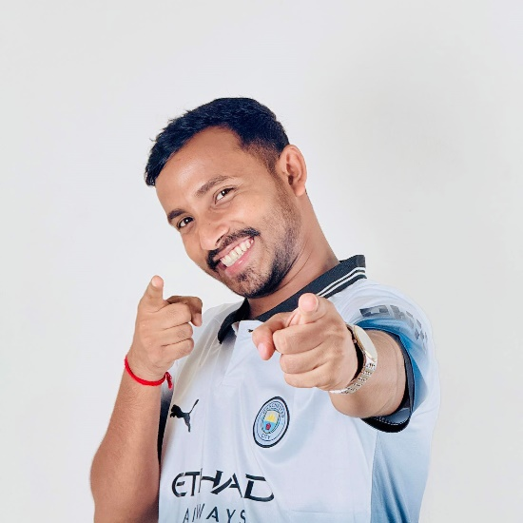

Sumon Sarkar
Our Mentor, Advanced Computer, Shohoj IT Institute.

Slide 16
Actually, I don’t have any words to describe my gratitude for them. I cant just thank them enough…

Slide 17
You're welcome to stick with me …

